Slide 1
Smart Home Security System
CEIS101 Final Course Project
July 2024
Imogene Bibbs
Prof. /Darniet Jennings/

Slide 2
Introduction
For this project we created a smart home security system from scratch.
The objective of this project was to make connections to indicate when the door was open, closed or there was a security breach.
The tools that were used were Tinkercad, Powerpoint and Microsoft Word.

Slide 3
CEIS101 Module 2
Circuit Simulation in Tinkercad

Slide 4
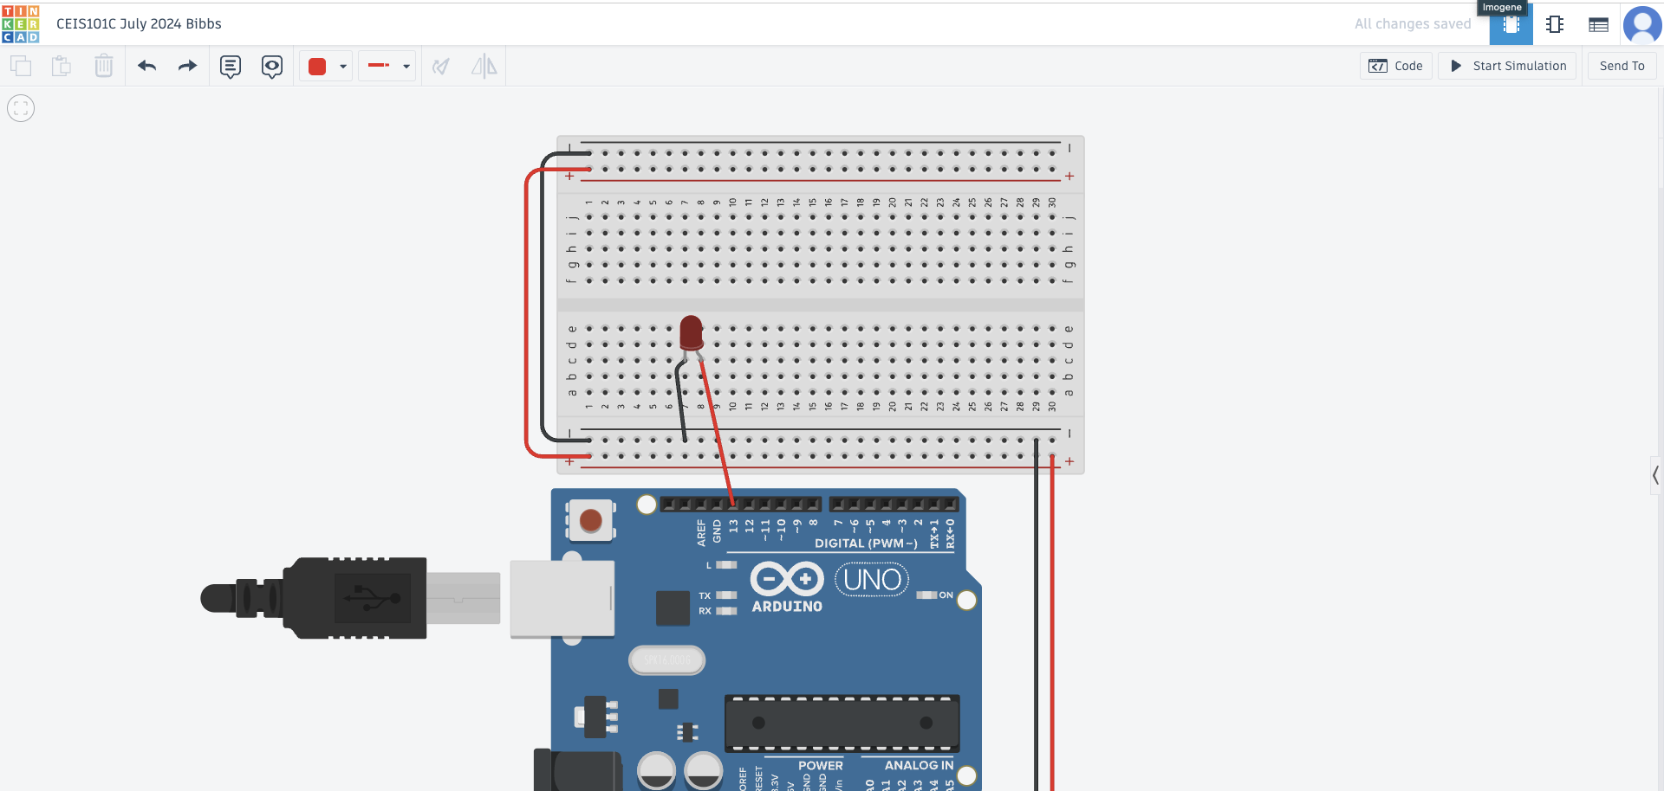
Circuit (screenshot)

Slide 5
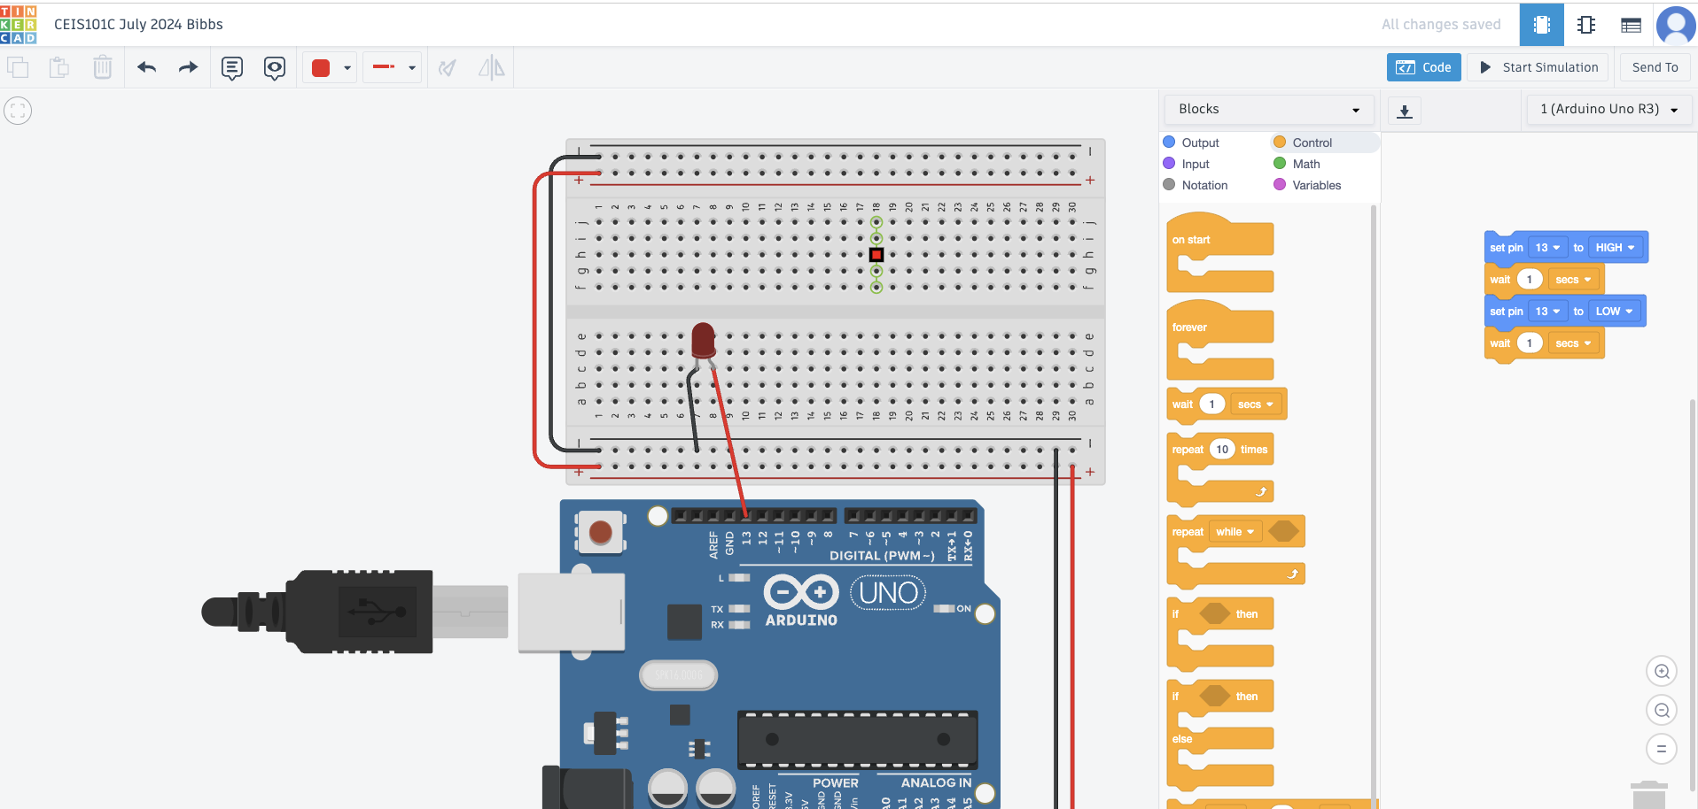
Code (screenshot)

Slide 6
CEIS101 Module 3
Inventory of Parts, Circuit Building, and Displaying Messages
Imogene Bibbs

Slide 7
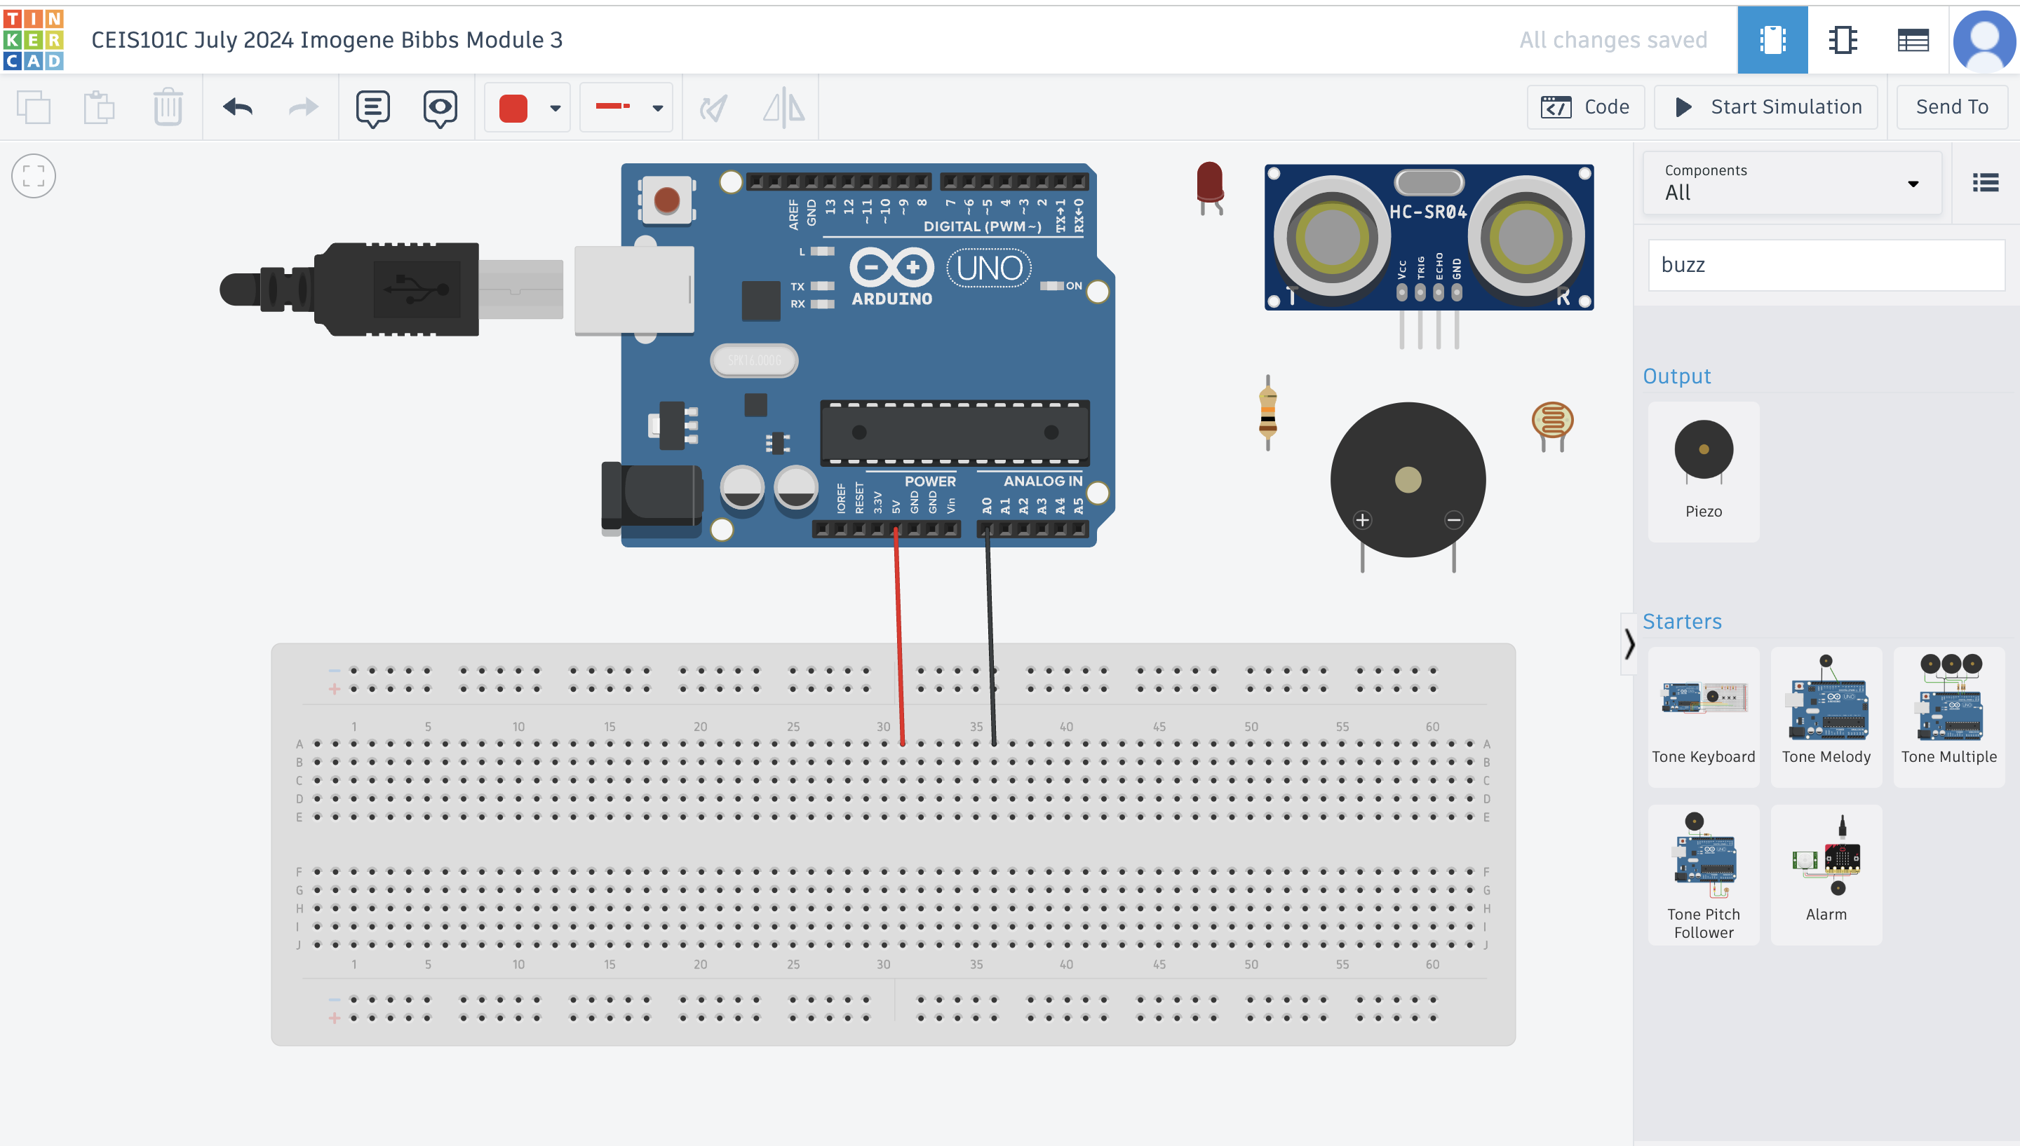
Organization of Project Components (picture)
Arduino Uno
Breadboard
Resistor 10kΩ
LEDs
Ultrasonic Sensor
Active Buzzer
Photoresistor
Wires

Slide 8
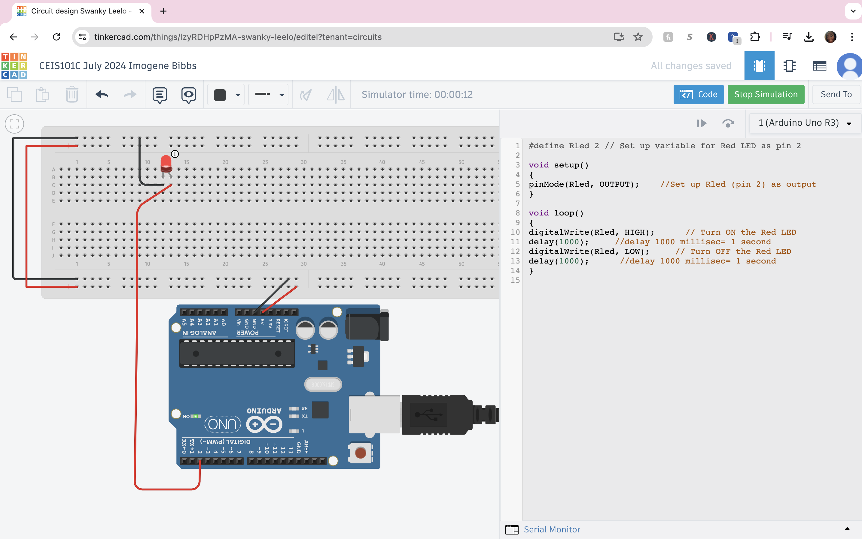
Circuit with red LED on (picture)

Slide 9
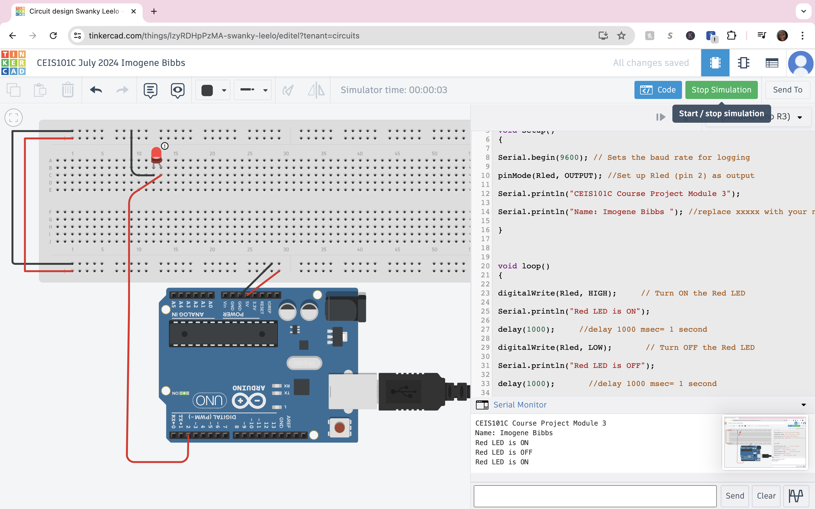
Serial Monitor (screenshot)

Slide 10
CEIS101 Module 4
Adding Door Sensor to Smart Home System
Imogene Bibbs

Slide 11
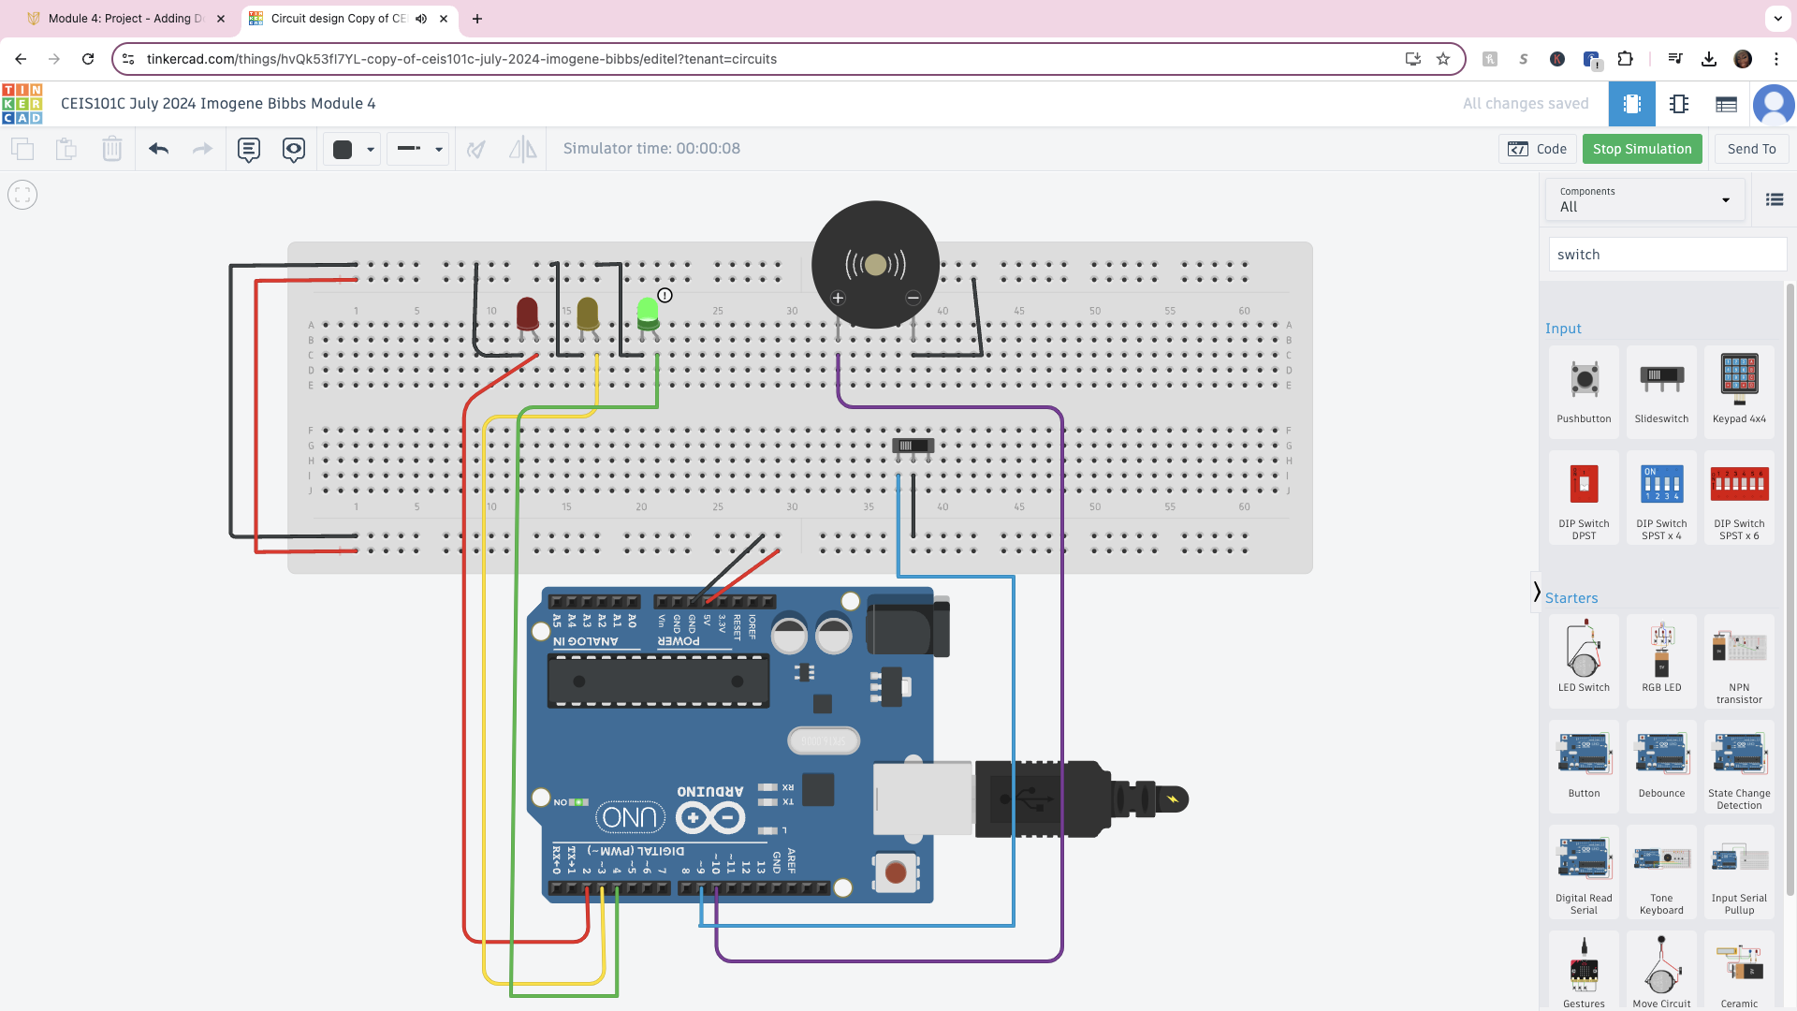
Circuit of door closed with Green LED ON (picture)

Slide 12
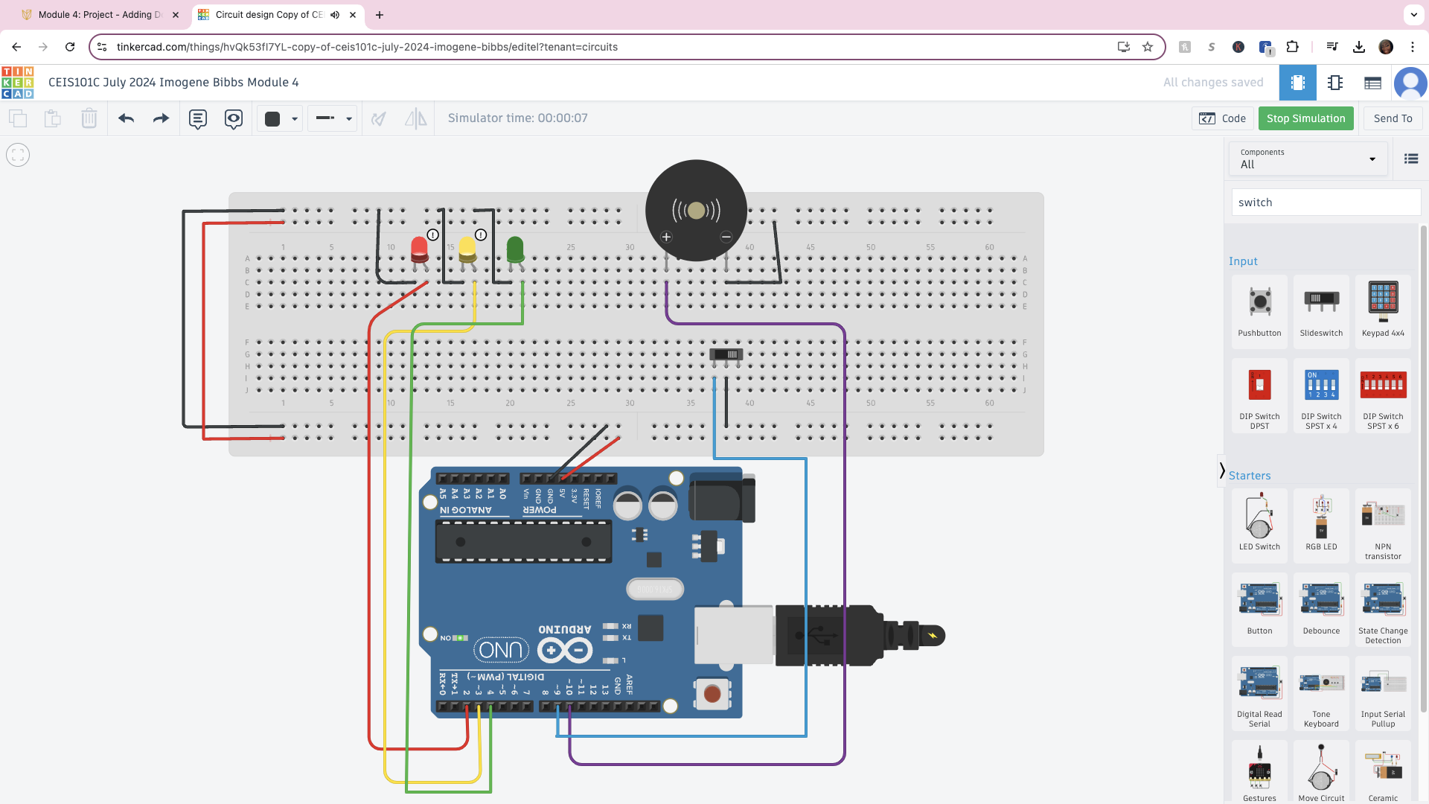
Circuit of door open with Green LED OFF (picture)

Slide 13
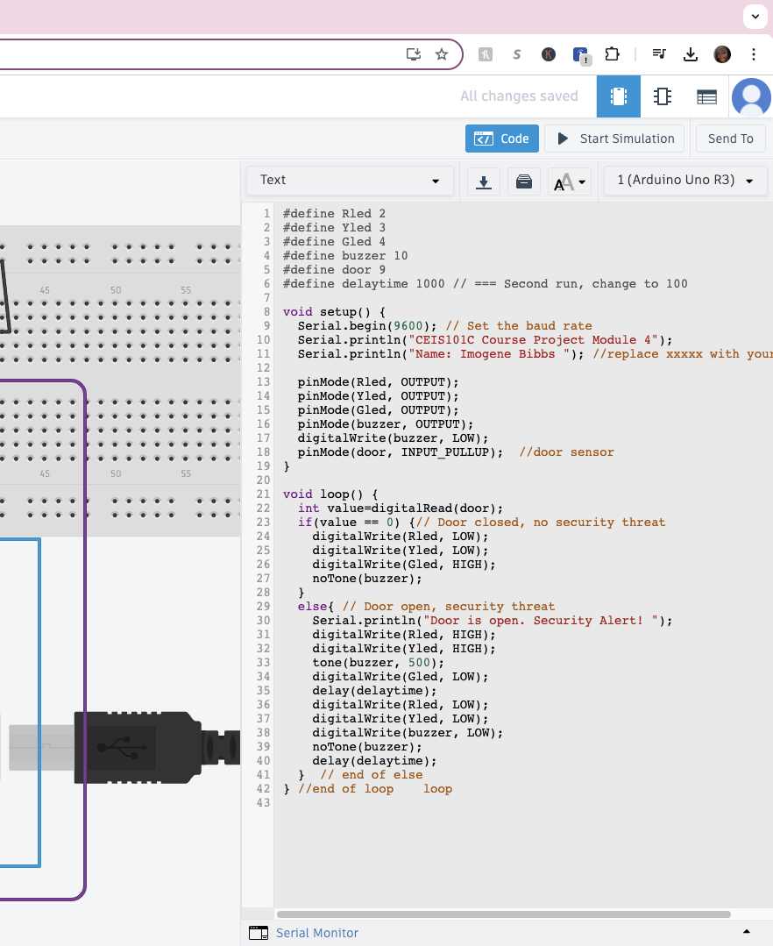
Arduino Code (screenshot)

Slide 14
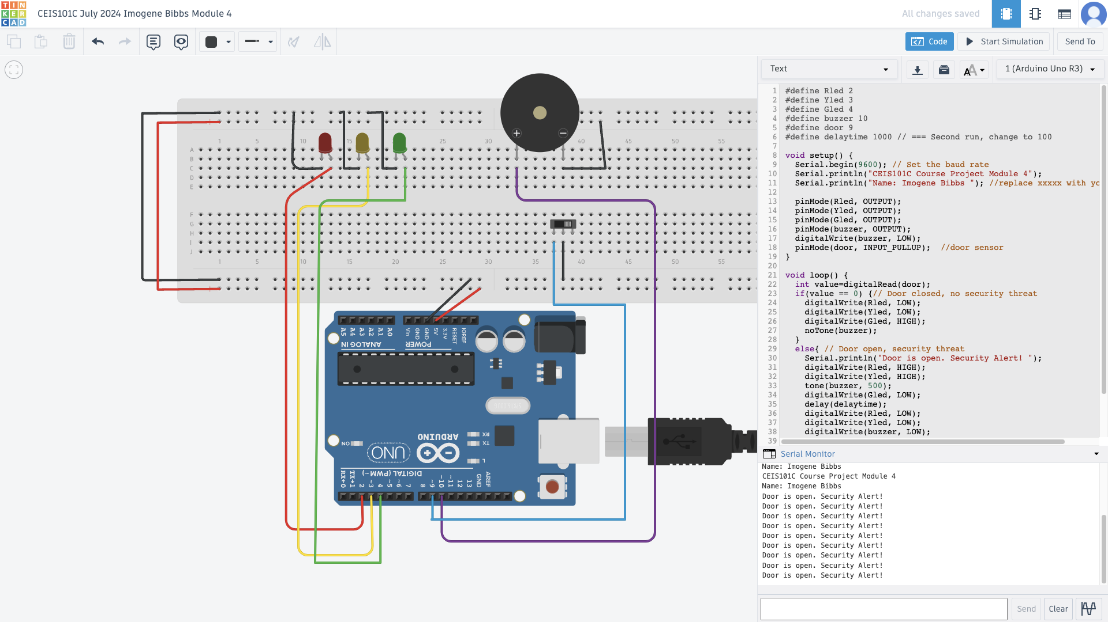
Serial Monitor (screenshot)

Slide 15
CEIS101 Module 5
Adding Distance Sensor to Smart Home System
and Conducting Data Analysis

Slide 16
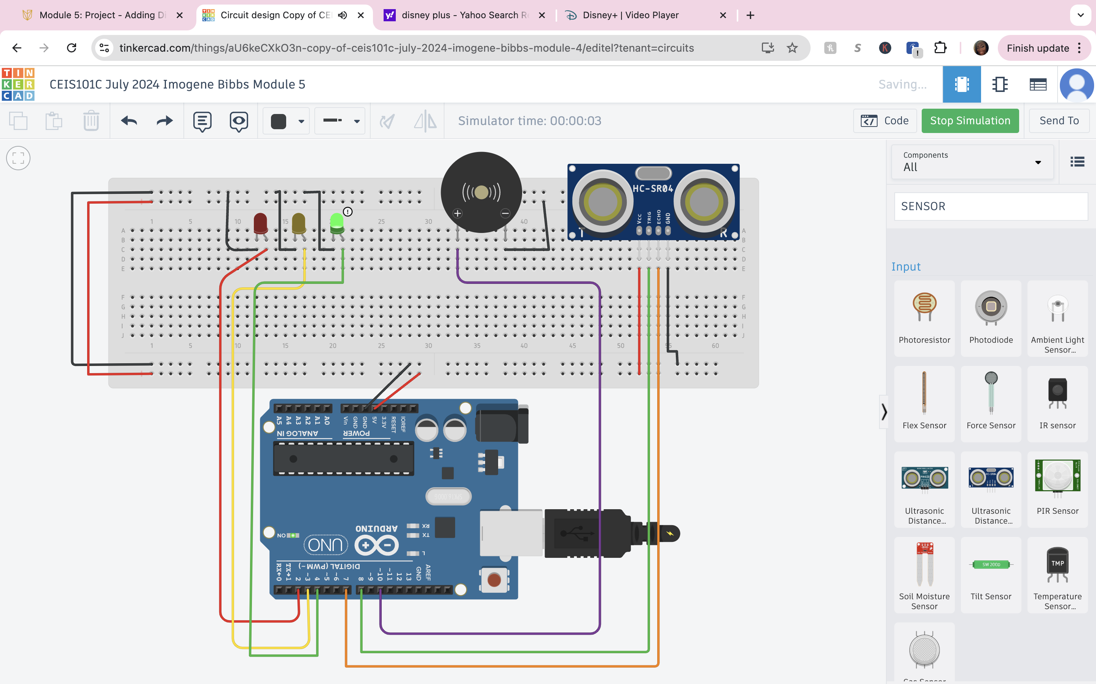
Circuit with green LED on (picture)

Slide 17
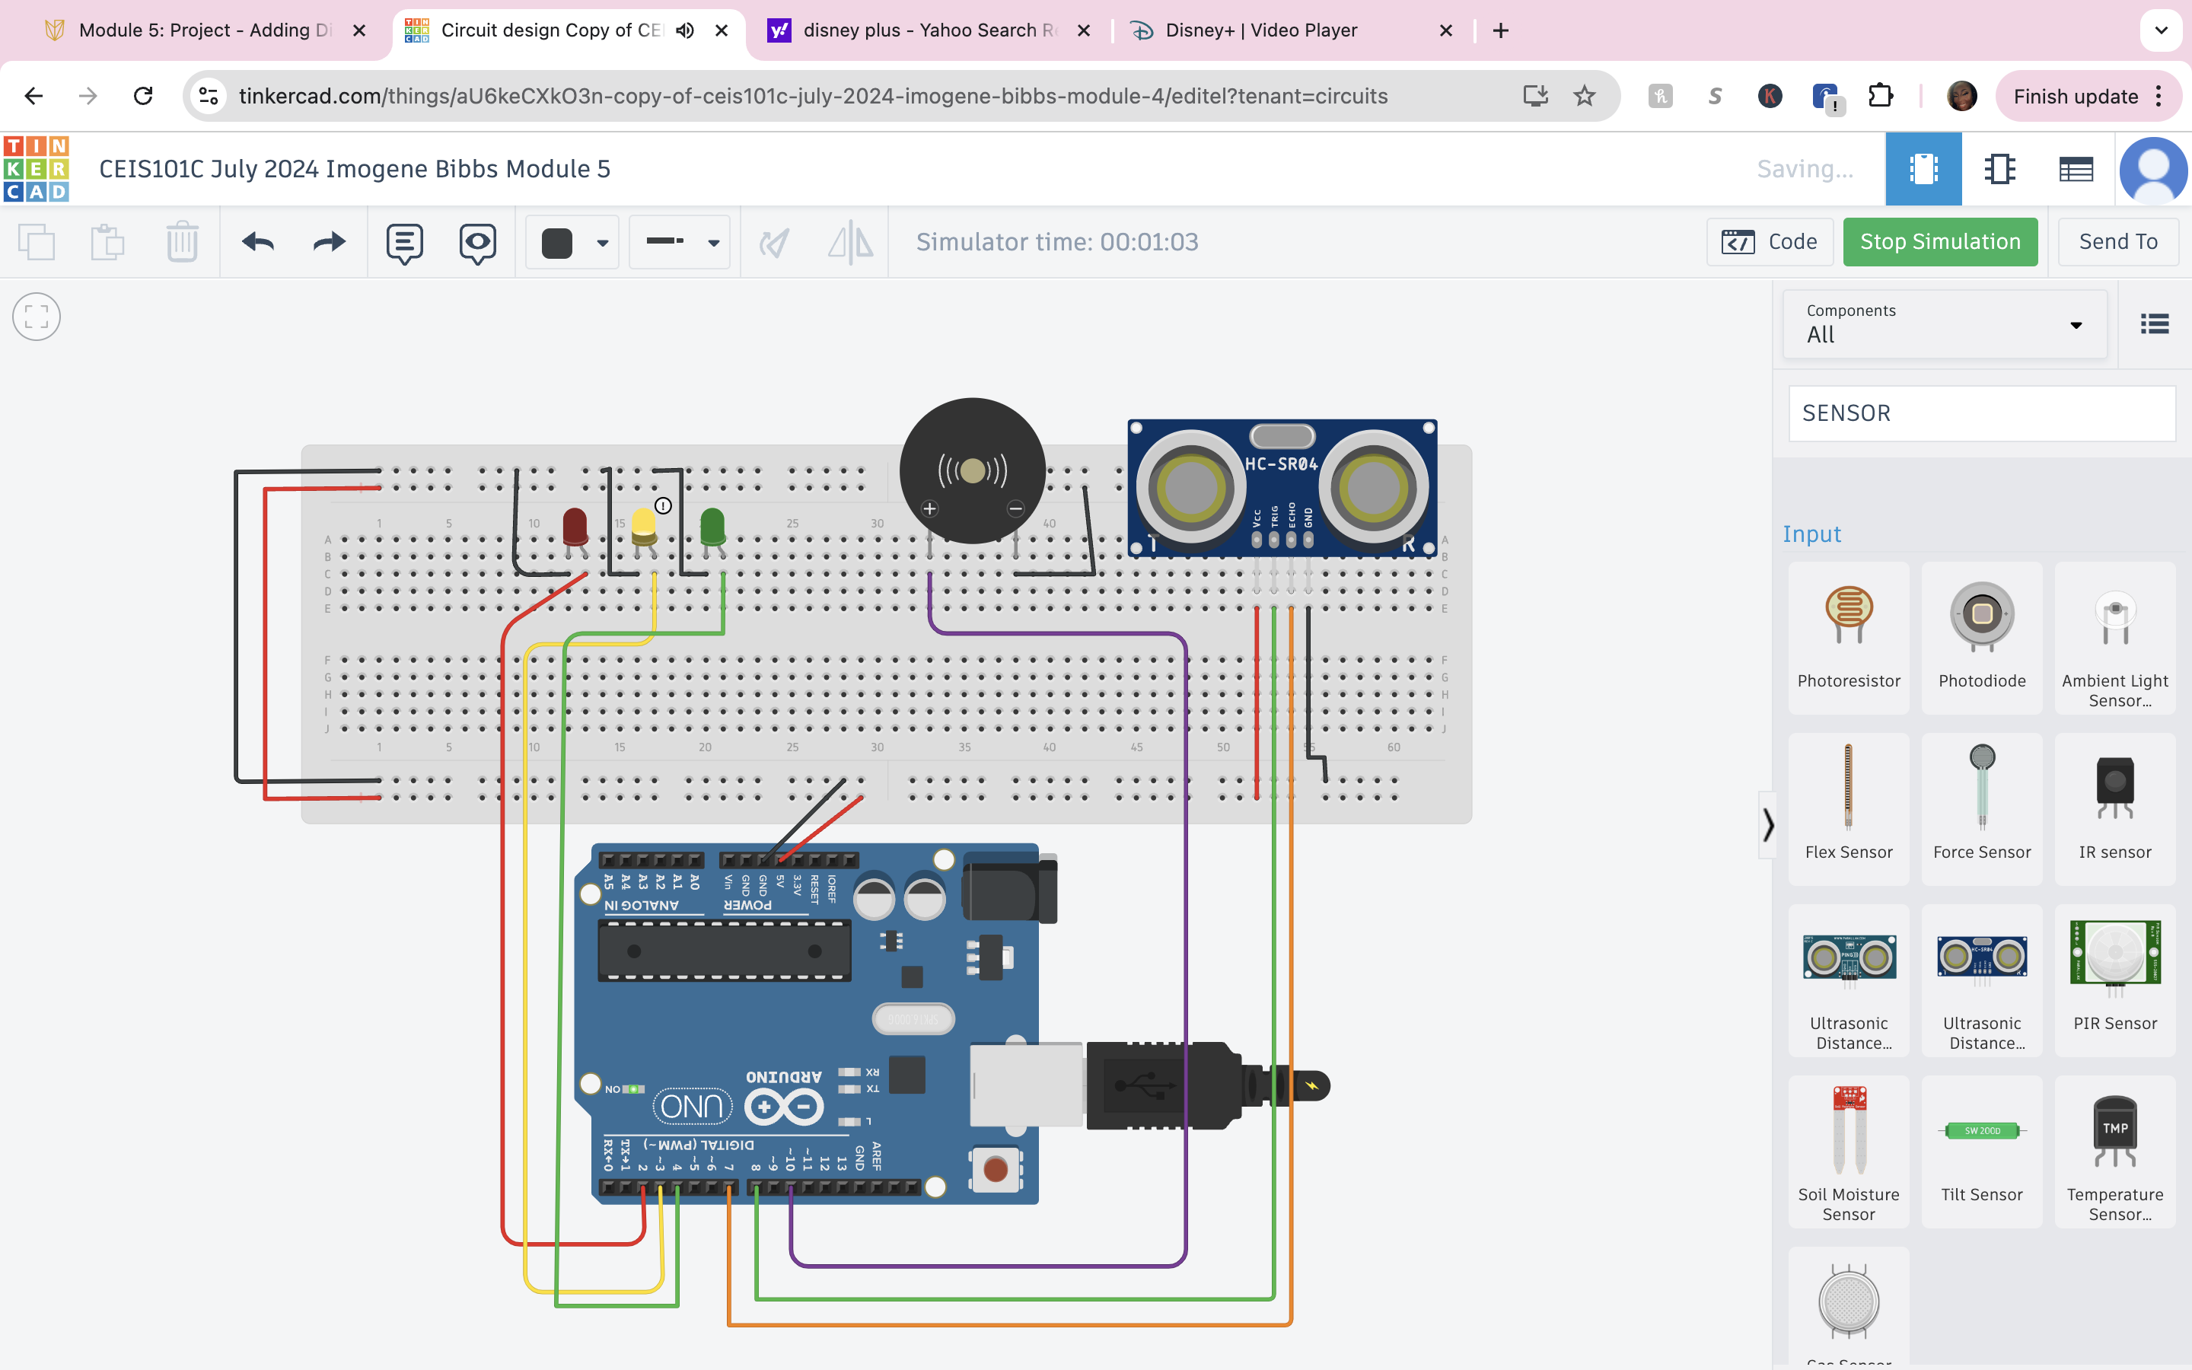
Circuit with yellow LED on (picture)

Slide 18
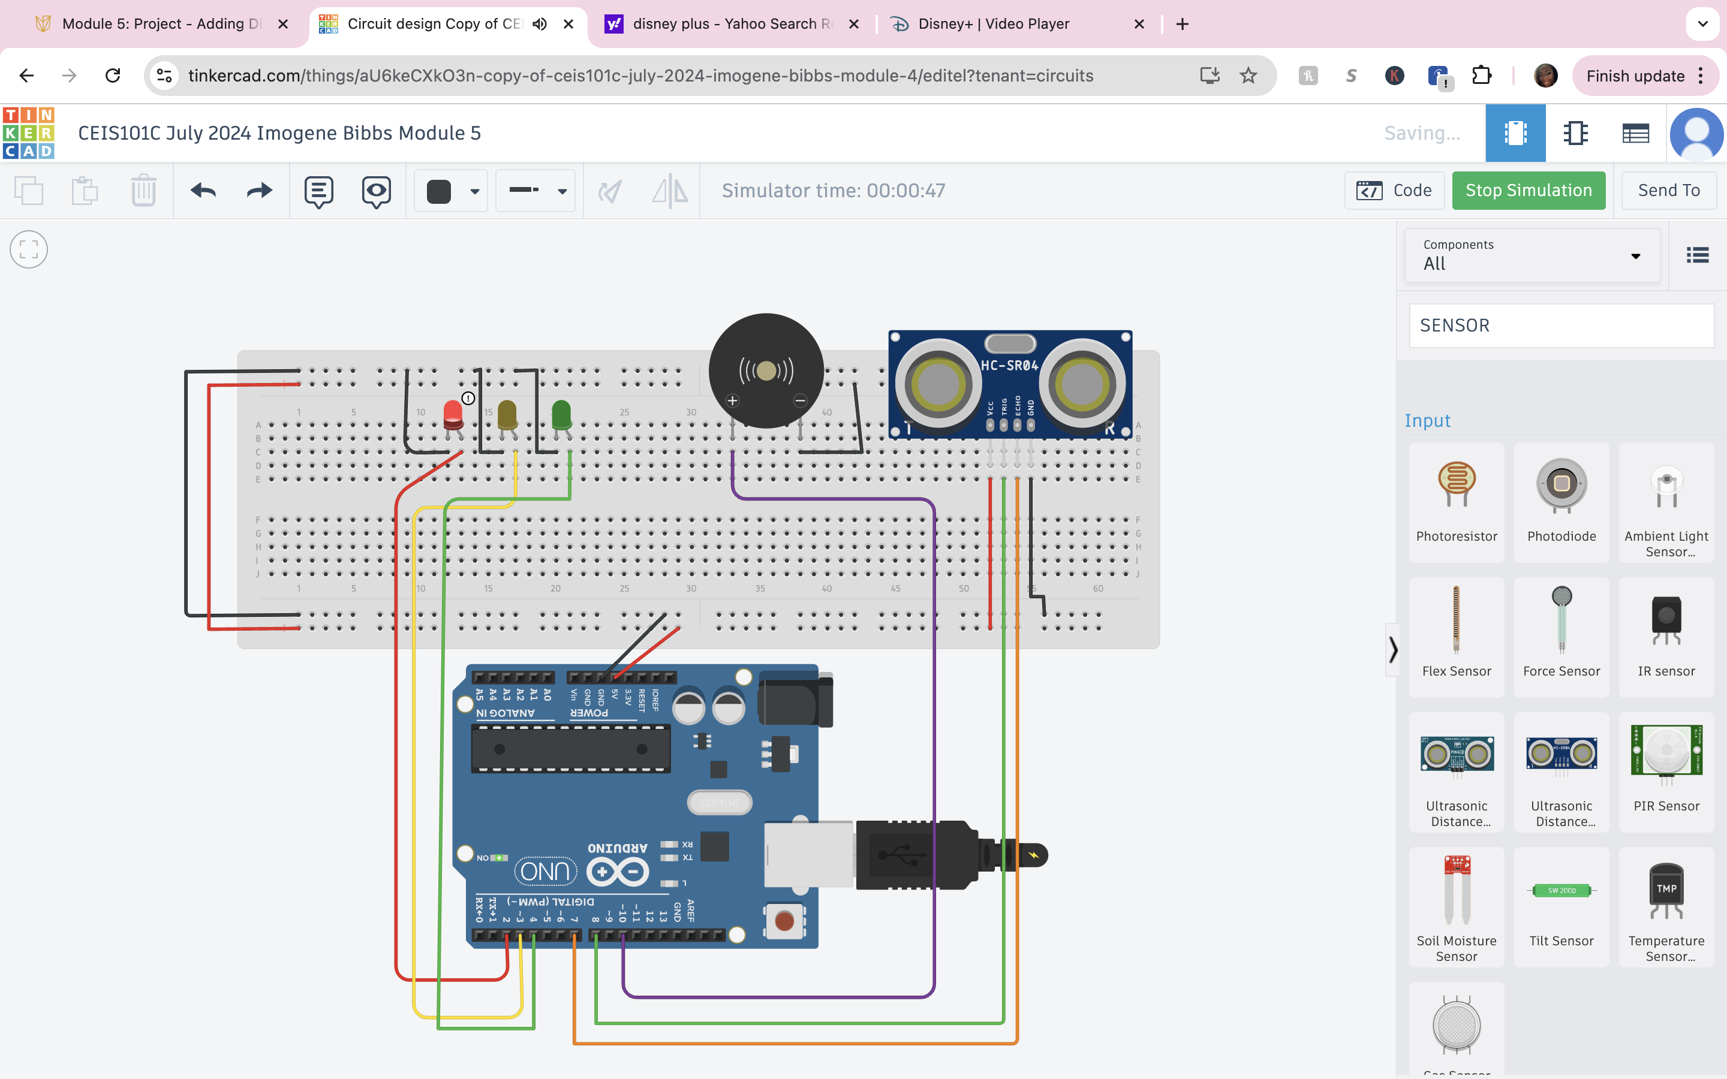
Circuit with red LED on (picture)

Slide 19
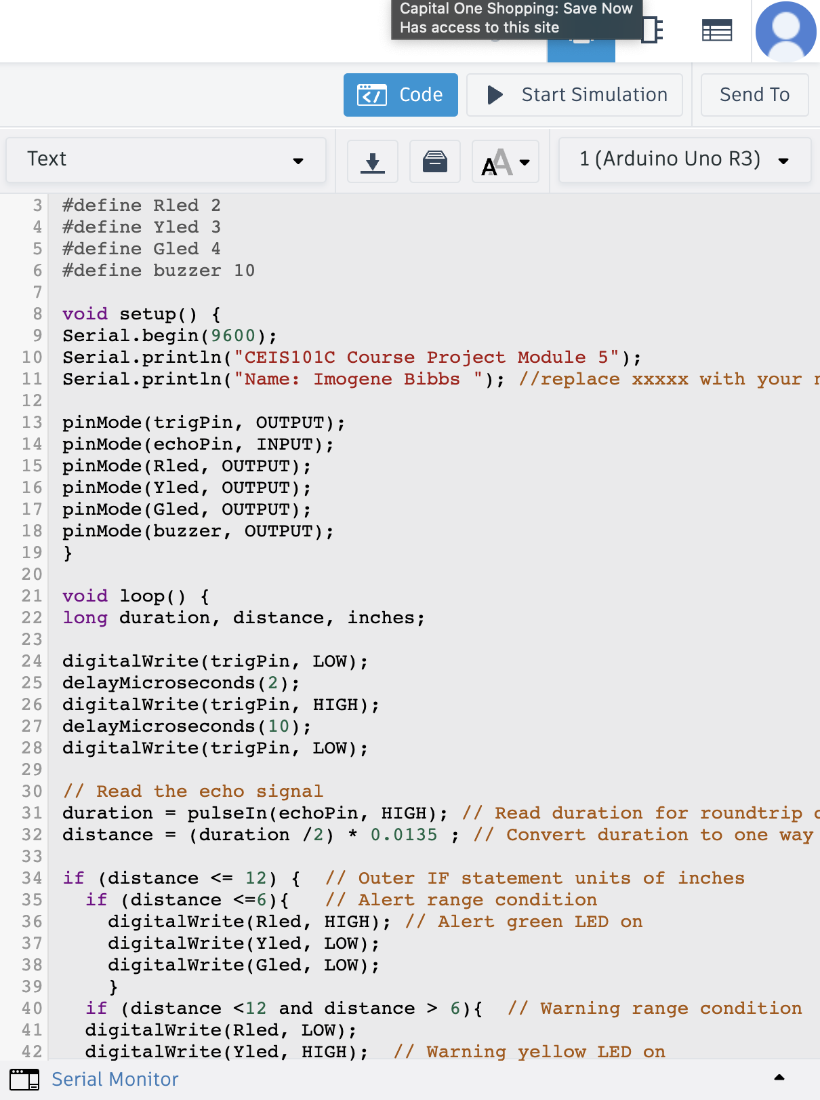
Arduino Code (screenshot)

Slide 20
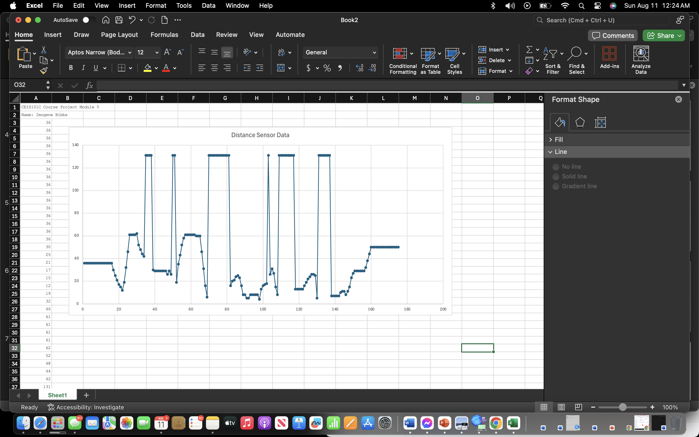
Plot of data (graph from Excel)

Slide 21
CEIS101 Module 6
Adding Automated Light to Smart Home System

Slide 22
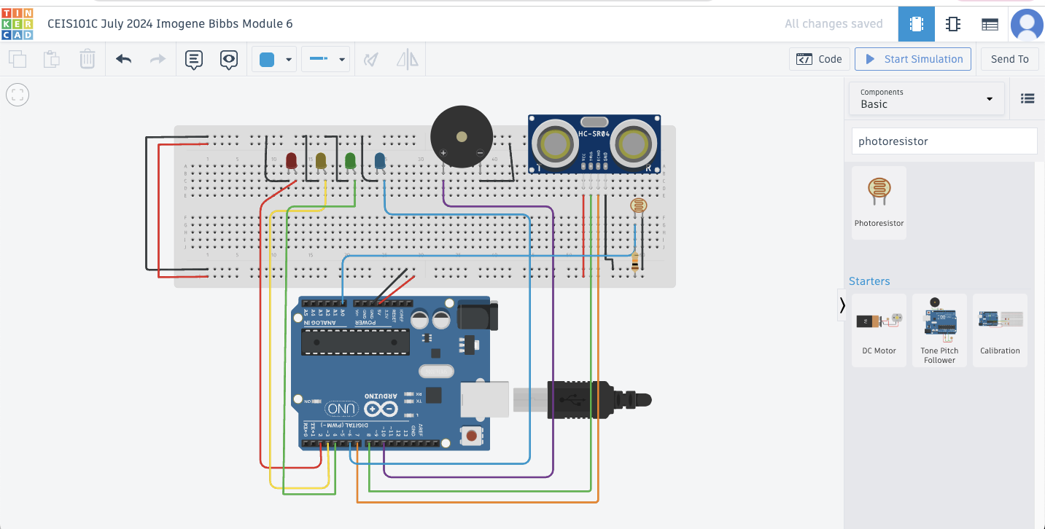
Circuit with automated LED off (picture)

Slide 23
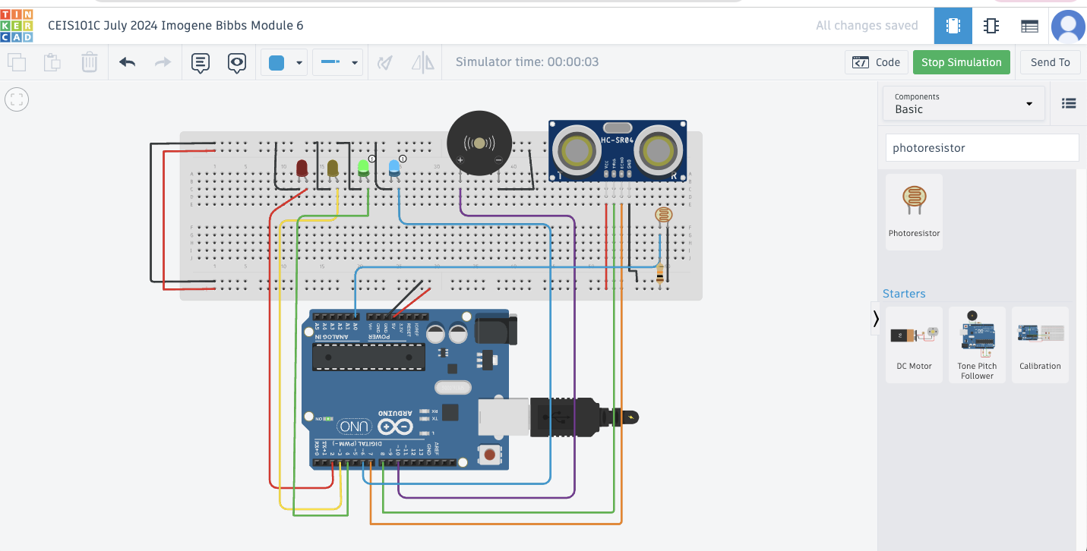
Circuit with automated LED on (picture)

Slide 24
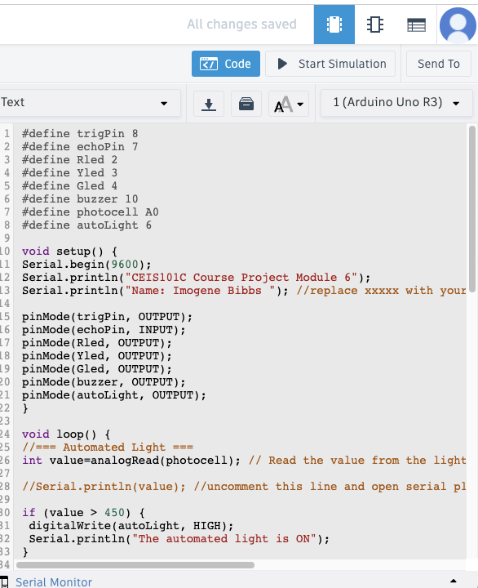
Arduino Code (screenshot)

Slide 25
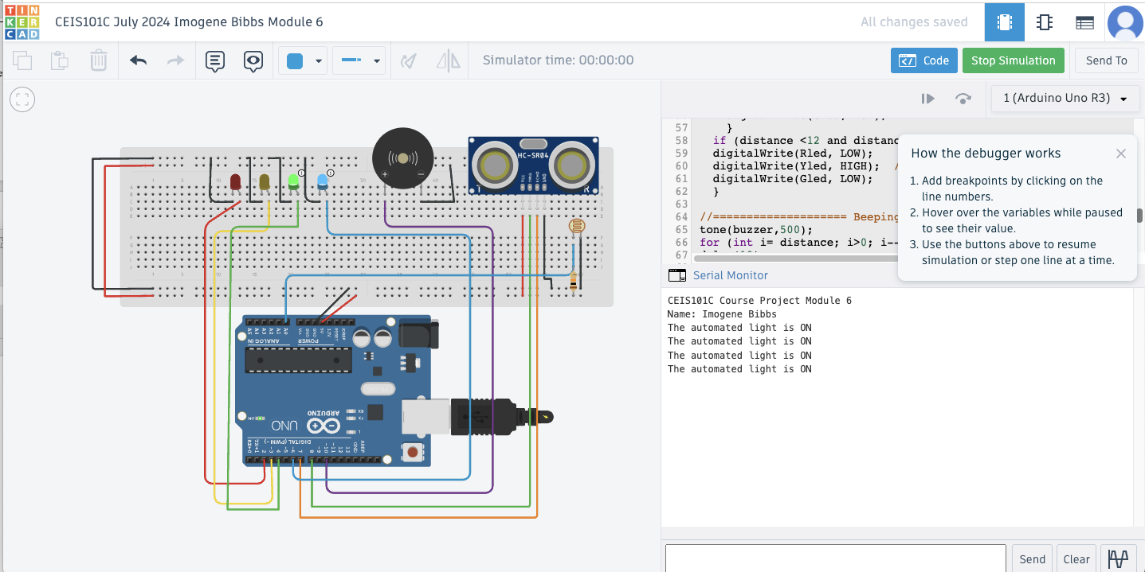
Serial Monitor (screenshot)

Slide 26
Challenges/Lessons Learned
Some of the challenges I faced in the beginning were getting used to working with Tinkercad. It was new to me and to navigate the program took some time.
How I overcame this challenge was I practiced creating different projects in Tinkercad on my own time to get familiar with the program.
I learned that with practice, consistency and familiarity I can achieve anything no matter how foreign it is to me.

Slide 27
Career Skills
I can now say that I have experience and familiarity with Tinkercad, creating circuits and enhanced my knowledge on components.
Some competencies that will help me to gain the opportunities to advance my career are problem-solving skills, adaptability and digital literacy.

Slide 28
Conclusion
In conclusion creating a smart home security system was both educational and fun. I learned so many different things and enhanced my knowledge on components, which is something I work with in my everyday job. Putting software, hardware and devices all into one system has been fulfilling and has given me experience that I can take with me into the workforce and to my resume.

Slide 29
References
www.tinkercad.com
The resources used for this project were the project templates and guides provided by the professor.

